Slide 1
Real-Time Soil Water and Fertilizer Measurement System Using Arduino and RS485
Name: Rimzim Bhurrak,Sajan Kushwaha,Vaishnavi Kachhi,Vindrawati Patel
College: Shri Ram Group of Institutions
Department:Electronics and Communication Engineering
Supervisor:Prof.Asmit Soni

Slide 2
1.PROJECT OBJECTIVE
The primary objective of this project "Real-Time Soil Water and Fertilizer Measurement System Using Arduino and RS485" is to enhance agricultural efficiency through an automated monitoring and control system. By integrating IoT-based smart farming techniques, this system provides real-time data on soil moisture, temperature, and humidity, ensuring optimal irrigation and resource utilization. The project aims to:
Improve crop yield by maintaining ideal soil conditions.
Reduce water wastage by automating irrigation systems.
Enable remote monitoring and control of agricultural processes.
Minimize human effort and intervention in field operations.

Slide 3
2. BACKGROUND
Agriculture is the backbone of many economies, yet challenges such as erratic weather patterns, overuse of water, and inefficient farming practices lead to reduced productivity. Traditional farming methods are labor-intensive and lack precision, resulting in resource wastage. With the advancement of embedded systems, IoT, and machine learning, smart farming techniques are being adopted to:
Provide farmers with real-time insights into soil and crop conditions.
Automate irrigation and nutrient management based on sensor data.
Improve decision-making through data-driven insights.
Reduce dependency on manual labor, making farming more efficient and sustainable.

Slide 4
3.FEATURES OF PROJECT
This smart agricultural system integrates multiple features for efficient farm management:
Real-Time Monitoring:
Continuous data collection from soil moisture, temperature, and humidity sensors.
Instant alerts on abnormal conditions.
Automated Irrigation System:
The system turns water pumps ON/OFF based on soil moisture levels.
Prevents over-irrigation or under-irrigation, optimizing water usage.
Remote Access and Control:
Farmers can monitor and control the system via a mobile app or web interface.
IoT integration allows data to be accessed from anywhere.
Cost-Effective and Energy Efficient:
Uses low-power microcontrollers and sensors.
Can be powered by solar panels for sustainable operation.
Data Analytics and Predictive Maintenance:
Logs environmental data for analysis.
Provides insights to improve farming practices.

Slide 5
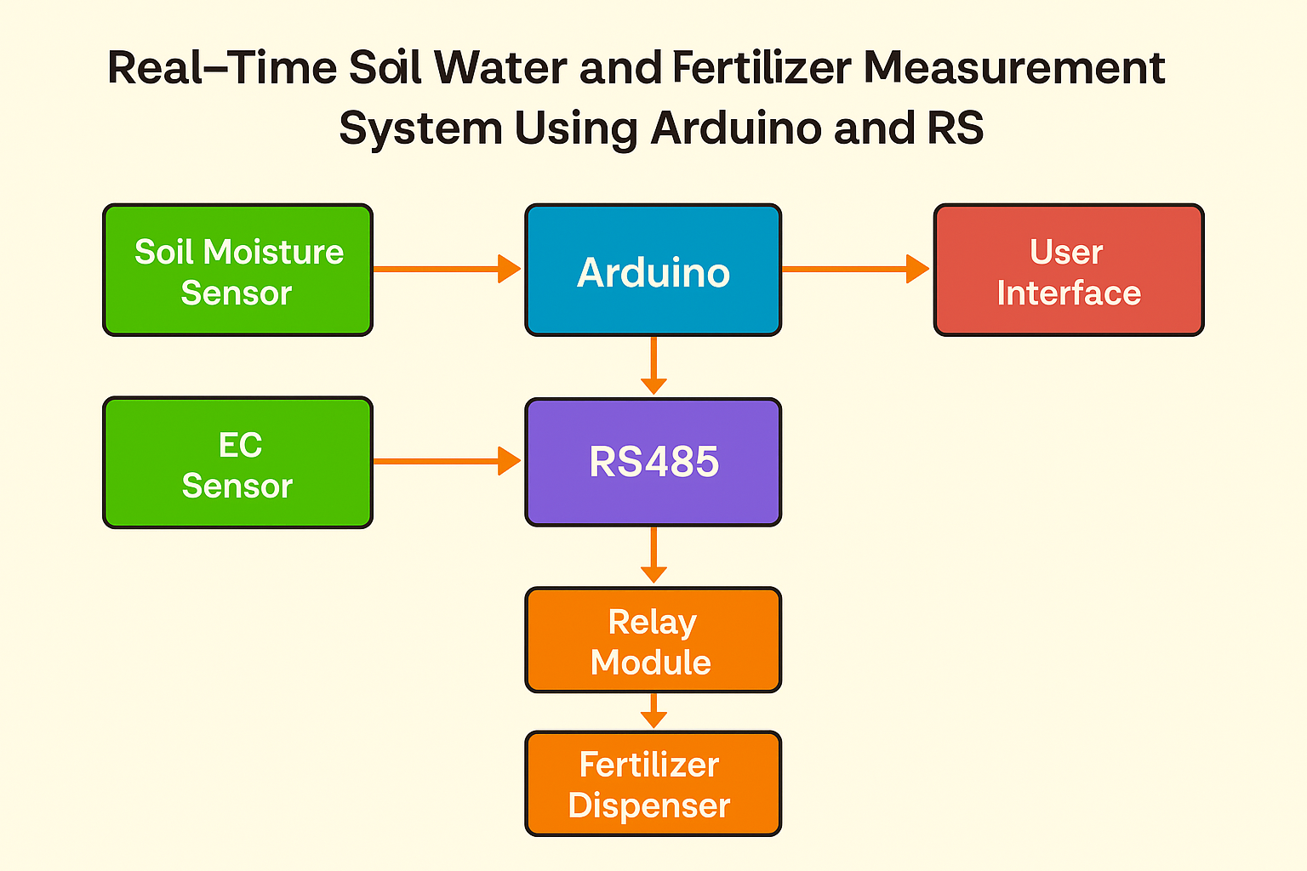
4. BLOCK DIAGRAM

Slide 6
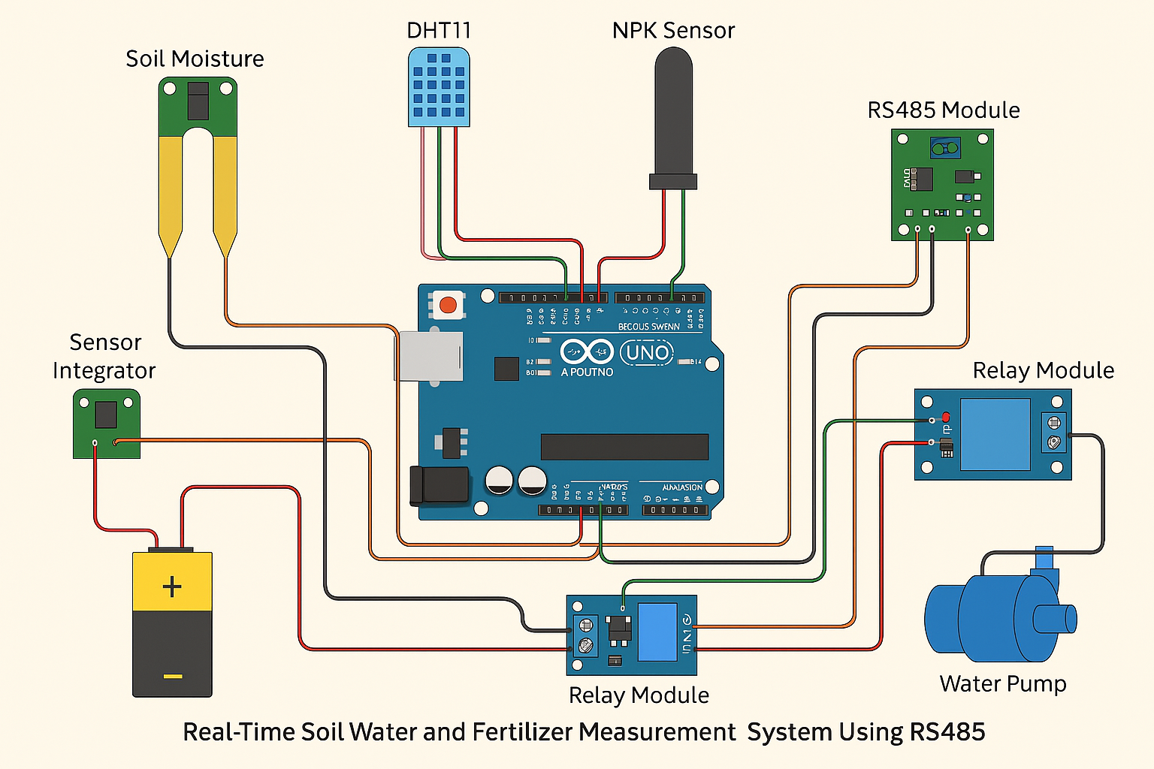
5. CIRCUIT DIAGRAM

Slide 7
6. HARDWARE COMPONENTS
Arduino Microcontroller : The central unit for processing sensor data and managing communication.
Soil NPK Sensor : Measures the levels of Nitrogen, Phosphorus, and Potassium in the soil.

Slide 8
Soil Moisture Sensor: Monitors the moisture content of the soil.
RS485 Module (TTL to RS485): Ensures reliable data transmission over long distances.
USB Connection: Facilitates data transfer from the Arduino to the laptop.

Slide 9
7. SOFTWARE
Arduino code for all sensors:
Sensor Integration:Arduino connect to NPK & moisture sensors to measure Nitrogen, Phosphorus,Potassium,and moisture levels.
Data Processing:Reads sensor data at intervals,processes it for accuracy.
RS485 Communication:Tranismits data over RS485 module for long-range,stable communication.
Real-Time Monitoring:Initially sends via USB to laptop for visualization.
Microcontroller Programming:Handling data acquisition,processing,and transmission efficiently.

Slide 10
Data Visualization & GUI Development:
Python-Based GUI: Uses Matplotlib & Tkinter to display real-time sensor data.
User-Friendly Interface: Allows easy monitoring of soil NPK & moisture levels.

Slide 11
8. TIME AND COST ANALYSIS
Development Duration: 3-4 Months
Hardware Selection & Purchase: 1-2 Weeks
Circuit Design & Assembly: 2-3 Weeks
Software Development & Testing: 3-4 Weeks
Integration & Deployment: 2 Weeks
Total Estimated Cost: ₹4000 - ₹7000
Microcontroller (Arduino/ESP32): ₹600 - ₹1200
Sensors (Moisture, Temp & Humidity): ₹350 - ₹700
Relay Module & Water Pump: ₹650 - ₹1800
GSM/Wi-Fi Module: ₹800 - ₹1500
Power Supply (Battery/Solar): ₹1000 - ₹3000
Miscellaneous (PCB, Wires, etc.): ₹500 - ₹1000

Slide 12
9.APPLICATIONS
Smart Agriculture: Automates irrigation, reducing labor and water wastage.
Greenhouse Monitoring: Maintains optimal conditions for plant growth.
Soil Health Analysis: Helps farmers understand soil moisture trends.
Remote Farm Management: Enables real-time data access from distant locations.
Urban Gardening: Useful for automated watering systems in rooftop and indoor farming.

Slide 13
10.FUTURE ASPECTS
The project can be further enhanced through:
Artificial Intelligence Integration:
AI algorithms for predicting weather conditions and soil needs.
Drone Integration for Monitoring:
Drones with cameras and sensors for better field coverage.
Machine Learning for Crop Disease Detection:
AI-based image processing for identifying plant diseases early.
Solar-Powered IoT System:
Reduces energy dependency by using solar panels for power.
Blockchain for Agricultural Data Security:
Secures farmer data and transactions for precision agriculture.

Slide 14
11.CONCLUTION
The Real-Time Soil Water and Fertilizer Measurement System provides an efficient tool for farmers, gardeners, and researchers to monitor and manage soil conditions. By leveraging real-time data on soil moisture and NPK levels, the system ensures optimized water and fertilizer usage, enhancing crop health and productivity.
Key Highlights:
Efficient Water Management
Smart Fertilization
Eco-Friendly

